Slide 1
Therapies
Chapter 16

Slide 2
Announcements
Quiz 10 due 11/20 @ 11:59pm
Thursday (11/17) No class
Office hours canceled for remainder of the week

Slide 3
Types of Psychology Professionals
Clinical Psychologists:
  May engage in verbal therapy, diagnose disorders through testing. Emphasis is on treating disorders. DO NOT PRESCRIBE MEDICINE
Psychiatrists:
  Prescribe medication! Do NOT engage in verbal therapy. Generally concerned with dosage of drugs, benefits of new medication, etc.
Counselors/Therapists:
  Primarily engage in verbal therapy. Help clients address emotional, social, and physical stressors in their lives. NOT FOCUSED ON PSYCHOLOGICAL DISORDERS

Slide 4
Psychological Biotherapy (Medicinal)
Methods for assisting individuals through the use of biological therapies
    Medication
    Surgery (in extreme cases)
  Typically completed by a psychiatrist or physician, NOT A PSYCHOLOGIST

Slide 5
Psychotherapy (Non-Medicinal)
Methods for assisting individuals in recognizing and overcoming psychological and interpersonal difficulties
  Nonmedical (i.e., without aid of drugs)
  Therapist, counselor, clinical psychologist
Typically done in person
  Movement towards therapy online (cybertherapy)

Slide 6
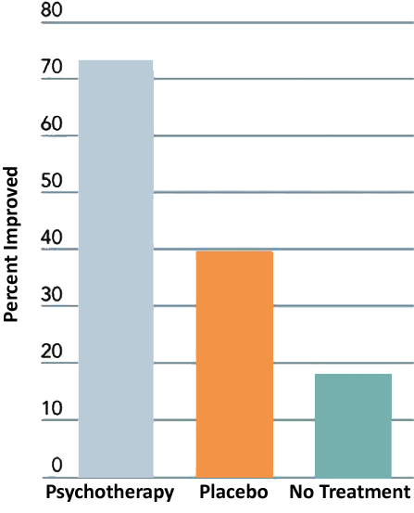
Psychotherapy
Does it work?
  i.e., Is therapy empirically supported?
  Why do all improve?

Slide 7
What makes Psychotherapy effective?
Therapeutic alliance
  The relationship between client and therapist
  Emphasize trust, respect, and cooperation
The Therapist
  Different styles (direct vs. indirect)
    Outspoken vs. more passive
The Client
  How much is the client participating?
  Therapy requires change which is difficult!

Slide 8
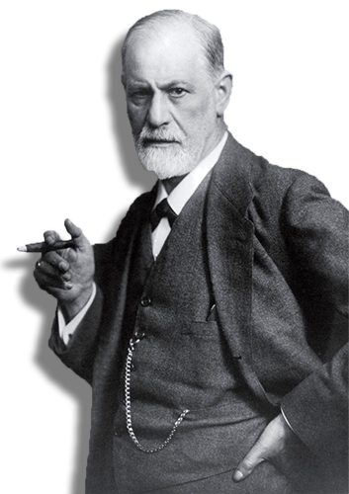
Psychodynamic Therapies
Emphasis…
  Early childhood experiences
Goals…
  Identify unconscious conflicts
  Therapeutic interpretation
    Transference – a client relating to the psychoanalyst (therapist) as a means to relive an important relationship in their life
    E.g., “What would you say to your parent if you saw them again? What would you hope to accomplish?”

Slide 9
Approaches to Psychological Disorders
Freudian Psychoanalysis
  Dream Interpretation/Analysis
  Transference
  Focused on sex drive
Contemporary Psychoanalysis…
  Emphasizes unconscious conflicts
  Downplays latent sexual desires

Slide 10
Humanistic Therapies
Emphasis…
  Conscious thoughts
  Self healing
  Self fulfillment
Goals…
  Self understanding
  Personal growth (“What can I do now to improve myself for the better?”)

Slide 11
Carl Rogers: Client-Centered Therapy
Indirect therapy type
  Emphasizes self exploration: With guidance, can you figure out what the issues are and how to fix them?
Warm, supportive, environment
  Remember: Unconditional Positive Regard!
  Active listening and reflective speech
  Empathy and genuineness

Slide 12
Behavior Therapies
Emphasis…
  Unconscious processes are not important
  Overt behavior change
Goals…
  Reduce or eliminate maladaptive behaviors
  Use of classical/operant conditioning

Slide 13

Behavior Therapies
Classical Conditioning is effective in treating phobias!
Systematic Desensitization
  Slow progression of exposure to a fearful stimulus
  Learn relaxation techniques (slow sympathetic NS response)
  E.g., Start with imagination, then seeing, then in the same room, then interaction
Flooding
  Intense exposure without allowing avoidance

Slide 14
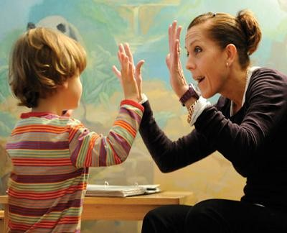
Behavior Therapies
Operant Conditioning Techniques
  Unlearning maladaptive behaviors (e.g., OCD repetitive behaviors) through altered consequences
Applied Behavior Analysis
  Positive reinforcement of adaptive behaviors
  Extinguish maladaptive behaviors (eliminate pairing with a reinforcing consequence)

Slide 15
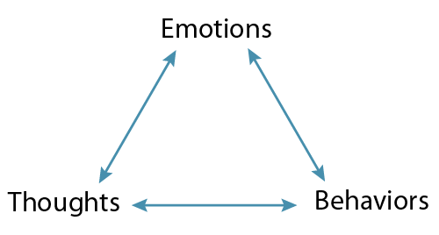
Cognitive Therapies
Emphasis…
  Thoughts (cognitions) are the main source of psychological problems
  Thinking = Feeling = Behaving
Goals…
  Cognitive restructuring: Changing how we think about a situation or a problem

Slide 16
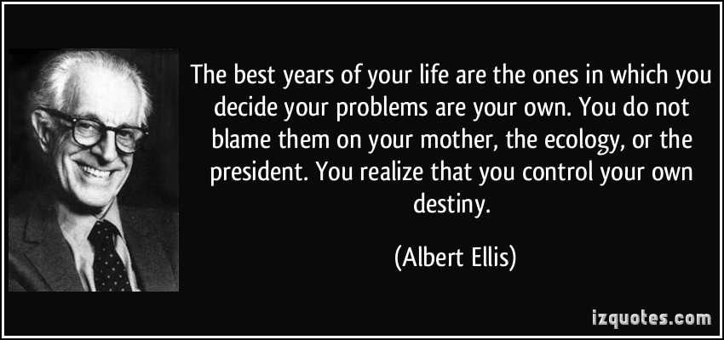
Cognitive Therapies
Rational Emotive Therapy – Albert Ellis
  We possess irrational, self-defeating, beliefs
  Eliminate these believes through rational examination
  Directive, persuasive, confrontational

Slide 17
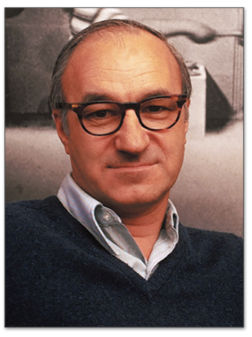
Cognitive-Behavior Therapy (CBT)
Albert Bandura and Self Efficacy
  Self Efficacy = Individual’s belief in ones abilities to achieve a goal
CBT aims to:
  Reduce self-defeating thoughts
  Incorporate behavior therapy
  Self-instructional methods
    Teaching clients how they can modify their own behaviors in novel situations (e.g., anger)

Slide 18
Therapy Integrations
No one therapy is effective for everything!
Integrating techniques from different therapies produce the greatest benefits!

Slide 19
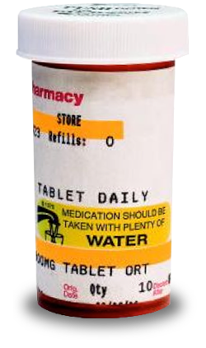
Biological Therapies
Alter bodily functioning to reduce symptoms
Common forms
  Drug therapy
  Electroconvulsive shock therapy (ECT)
  Surgery

Slide 20
Drug Therapies
Antianxiety Drugs
  Benzodiazepines (Xanax, Valium, etc.)
    Fast acting, but with side effects (fatigue, loss of coordination, mental slowing, affect developing children in womb, cannot be taken with alcohol)
  Buspirone
    Short-term effectiveness
    Users can develop a tolerance

Slide 21
Drug Therapies
Antidepressant Drugs
  Tricyclics/Tetracyclics (Elavil)
    Increase norepinephrine and serotonin (Balances Mood)
    60-70% effective, but side effects (memory loss, insomnia)
  Monoamine oxidase inhibitors (MAOIs)
    Monoamine oxidase breaks down serotonin
    Dietary side effects
  Selective Serotonin Reuptake Inhibitors (SSRIs)
    Zoloft, Paxil, Lexapro, Prozac
    Effective
    Minimal side effects (one major one is decreased sex drive)

Slide 22
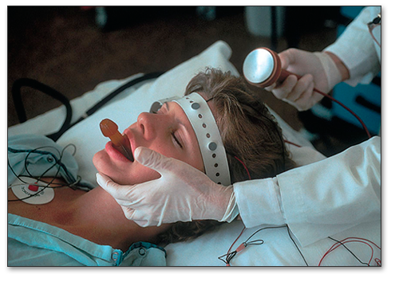
Biological Therapies
Electroconvulsive Therapy
  Small electric current produces a brief seizure, typically aimed at frontal regions
  Used to treat major depressive disorder, when patient is unresponsive to other types of treatments

Slide 23
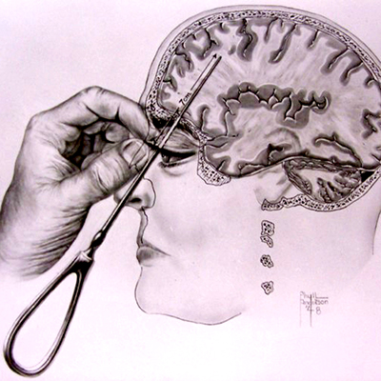
Biological Therapies
Surgery (psychosurgery)
  Prefrontal lobotomies
  Used in epileptics, but rarely used for other disorders*
Egas Moniz (developer) actually won a Nobel for this is 1949!

Slide 24
Sociocultural Therapies
Group Therapy
  Group shares disorder
  Professional facilitates
Family/Couples therapy
  Symptoms are a function (or dysfunction ☺) of the relationship
  Focus on validation within a group
  “Detriangulation” (preventing one family member from being the scapegoat)

Slide 25
Sociocultural Therapies
Self-Help Support Groups
  Conducted by Paraprofessionals (someone who is taught or overseen by a professional)
  E.g., AA groups
Community Mental Health
  Empower individuals within a community
  Job skills training, nutrition courses
  Prevent poverty, institutionalization

Slide 26
Done! Reminders!
Quiz 10 due 11/20 @ 11:59pm
Thursday (11/17) No class
Office hours canceled for remainder of the week

